Slide 1
Tableau Hands-On
By: Alexander Olvera

Slide 2
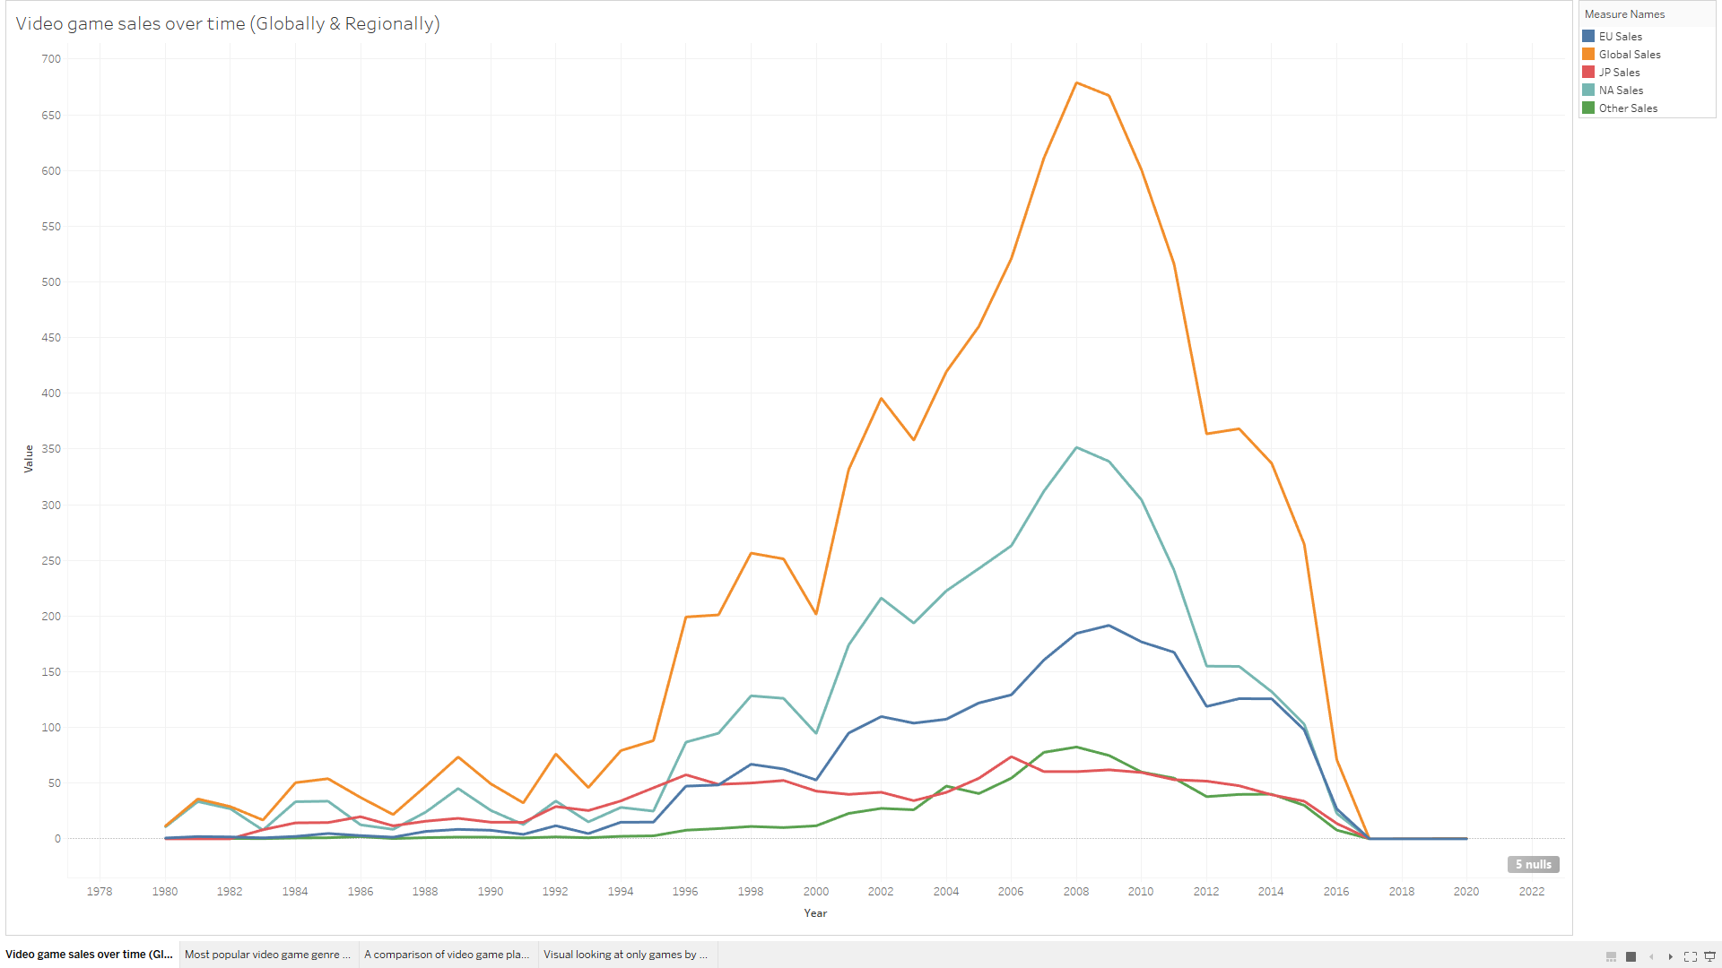
How video game sales have been trending over time

Slide 3
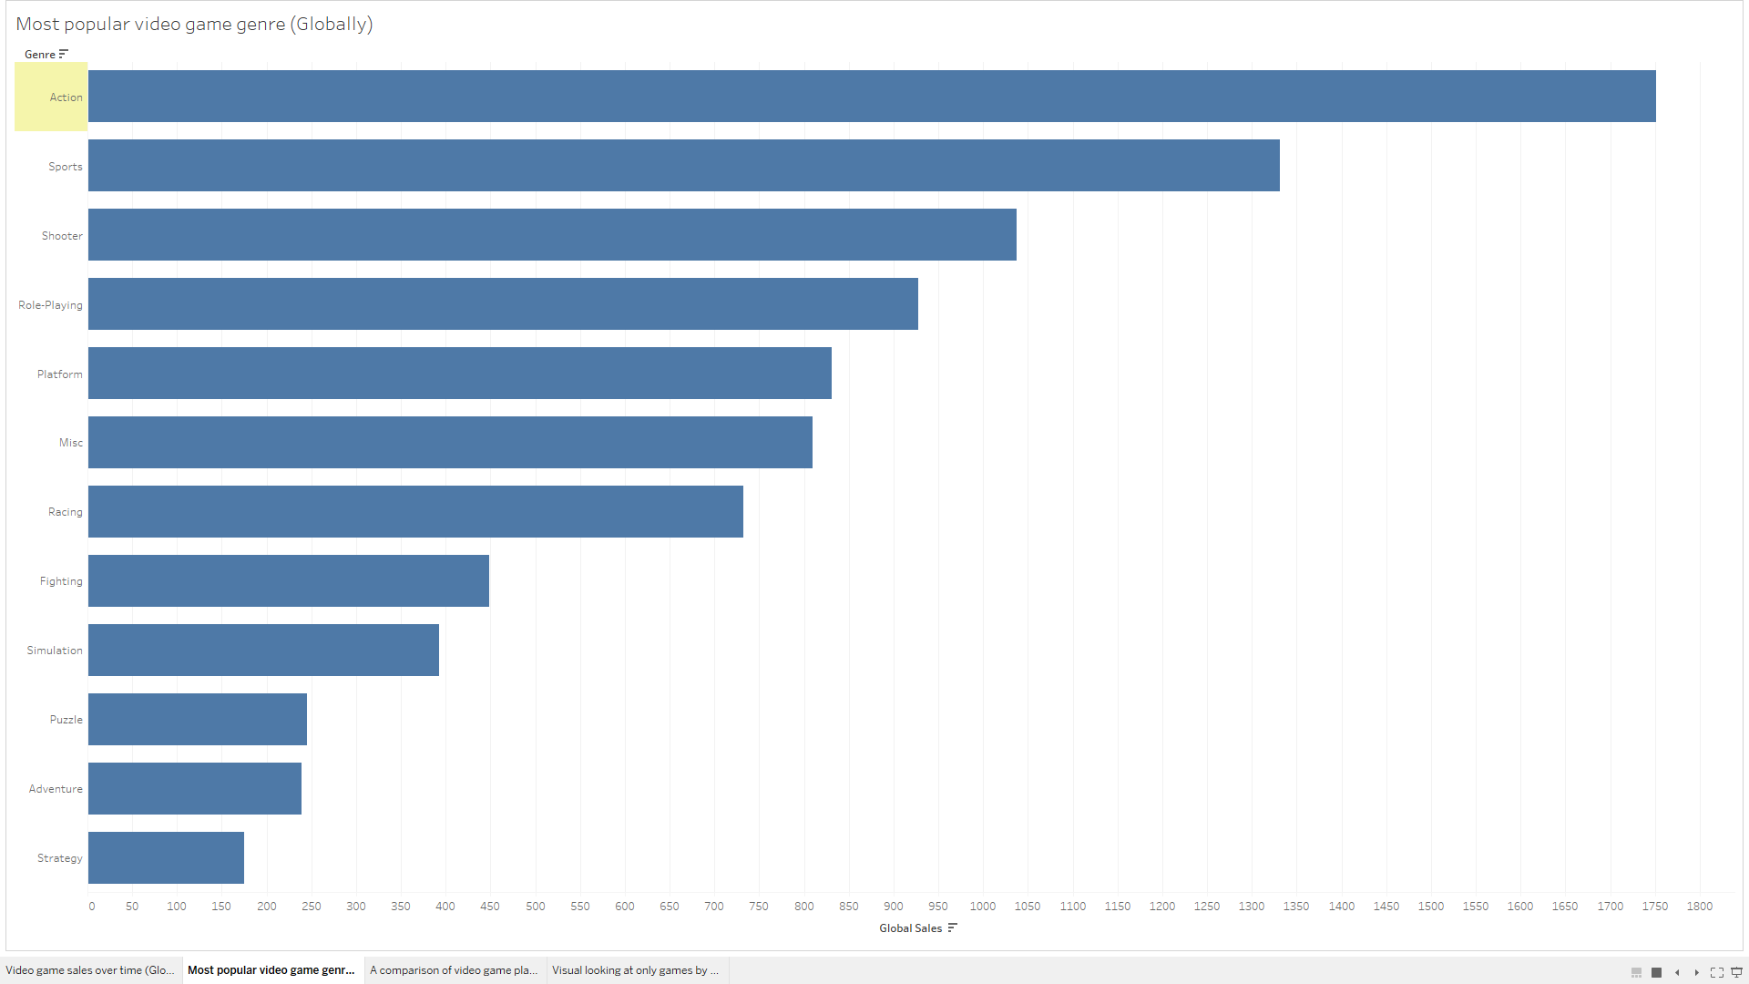
The most popular genre of video game

Slide 4
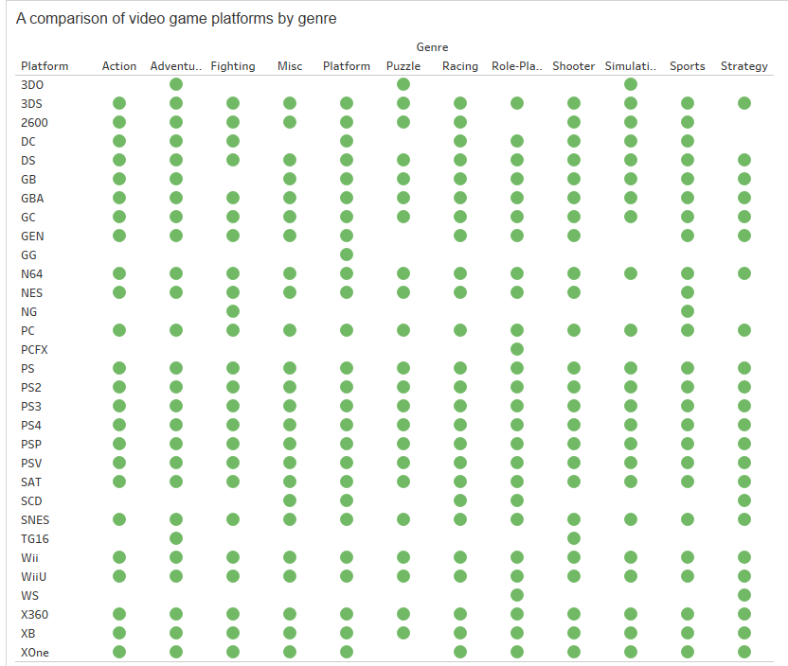
A comparison of video game platforms by genre

Slide 5
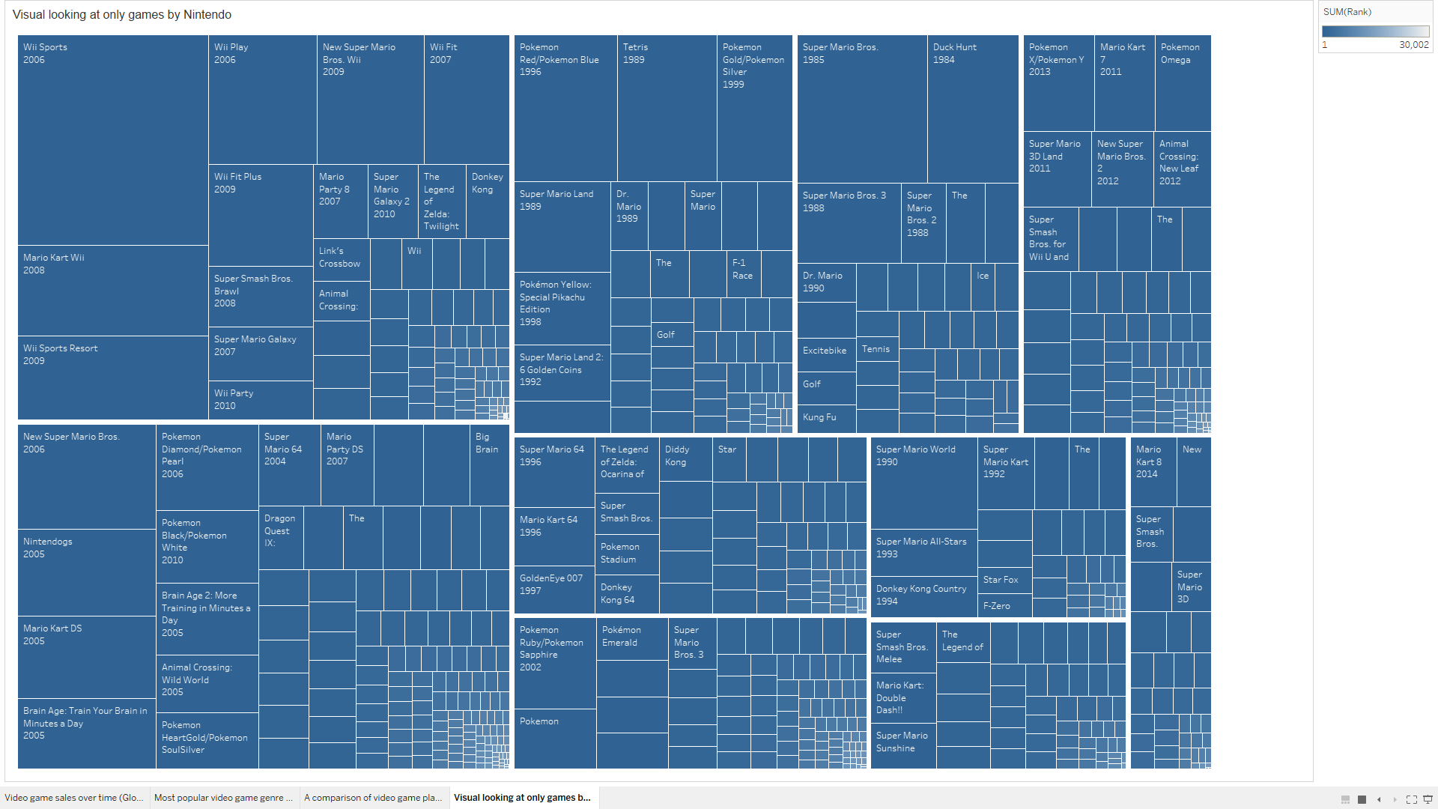
A visual looking at only games by Nintendo

